Slide 1
INSTRUCTION EXECUTION CYCLE WITH INTERRUPTS
Computer Organization and Assembly Language
Computer Science Department
National University of Computer and Emerging Sciences Islamabad

Slide 2
Von Neumann Architecture

Slide 3
VON NEUMANN/TURING
Stored Program concept
Main memory storing programs and data
ALU operating on binary data
Control unit interpreting instructions from memory and executing
Input and output equipment operated by control unit
Princeton Institute for Advanced Studies
  IAS
Completed 1952

Slide 4

STRUCTURE OF VON NEUMANN MACHINE

Slide 5
IAS - DETAILS
1000 x 40 bit words(1000 storage locations and 40 binary digits)
  Binary number
  2 x 20 bit instructions
Set of registers (storage in CPU)
  Memory Buffer Register
  Memory Address Register
  Instruction Register
  Instruction Buffer Register
  Program Counter
  Accumulator
  Multiplier Quotient
Notes:
Instruction Register- Contains the 8-bit opcode instruction being executed.
Instruction Buffer Register- Employed to hold temporarily the right hand instruction from a word in memory

Slide 6
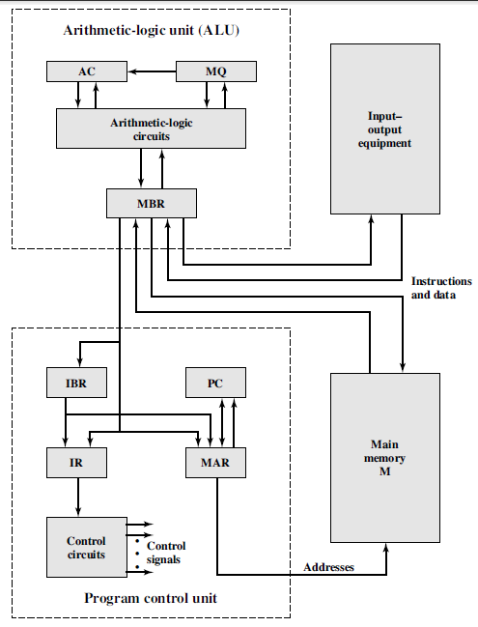
STRUCTURE OF IAS-DETAIL

Slide 7
Instruction Execution Cycle

Slide 8

INSTRUCTION CYCLE
Two steps:
  Fetch
  Execute

Slide 9
FETCH CYCLE
Program Counter (PC) holds address of next instruction to fetch
Processor fetches instruction from memory location pointed to by PC
Increment PC
  Unless told otherwise
Instruction loaded into Instruction Register (IR)
Processor interprets instruction and performs required actions

Slide 10
EXECUTE CYCLE
Processor-memory
  data transfer between CPU and main memory
Processor I/O
  Data transfer between CPU and I/O module
Data processing
  Some arithmetic or logical operation on data
Control
  Alteration of sequence of operations
  e.g. jump
Combination of above

Slide 11
INSTRUCTION EXECUTE CYCLE
Instruction
Fetch
Obtain instruction from program storage
Instruction
Decode
Determine required actions and instruction size
Operand
Fetch
Infinite Cycle
Locate and obtain operand data
Execute
Compute result value and status
Writeback
Result
Deposit results in storage for later use

Slide 12
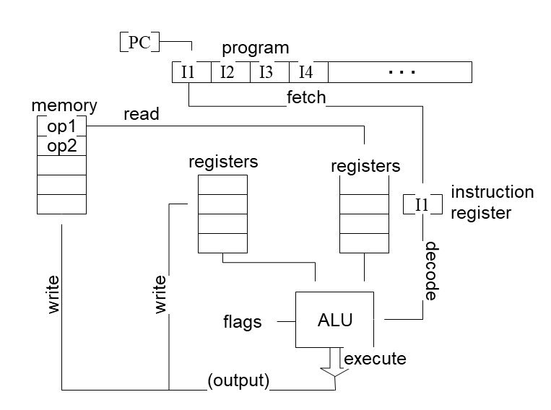
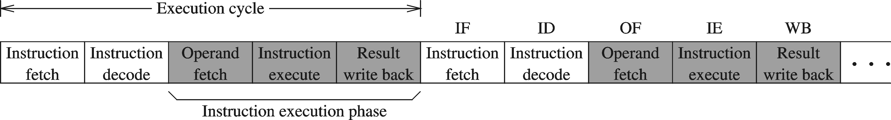
INSTRUCTION EXECUTION CYCLE – CONT'D
Instruction Fetch
Instruction Decode
Operand Fetch
Execute
Result Writeback

Slide 13
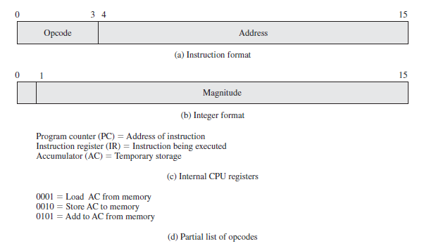
EXAMPLE OF PROGRAM EXECUTION

Slide 14
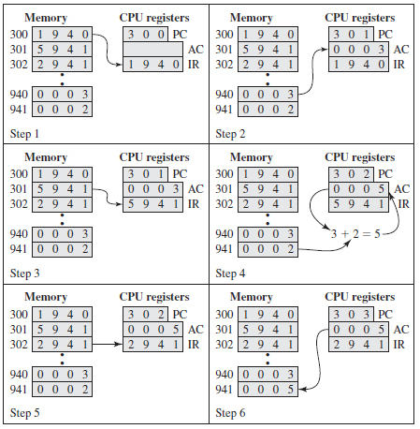
EXAMPLE OF PROGRAM EXECUTION
Figure 3.4 Characteristics of a Hypothetical Machine

Slide 15
Interrupts

Slide 16
INTERRUPTS
Mechanism by which other modules (e.g. I/O) may interrupt normal sequence of processing
Program
  e.g. Arithmatic overflow, division by zero
Timer
  Generated by internal processor timer
  Used in pre-emptive multi-tasking
I/O
  from I/O controller
Hardware failure
  e.g. Power failure, memory parity error
Notes:
I/O—to signal normal completion of an operation or to signal a variety of error conditions
Parity Error-A parity error was detected within the system memory. Parity checking is used to detect memory corruption between the time that data is written to memory and the time that it is read back.This error message means that there is a problem associated with the system memory.

Slide 17
INTERRUPTS
The normal execution of the current program must be interrupted – the device raises an interrupt signal.
Interrupt-service routine
Current system information backup and restore (PC, general-purpose registers, control information, specific information)

Slide 18
INTERRUPT CYCLE
Added to instruction cycle
Processor checks for interrupt
  Indicated by an interrupt signal
If no interrupt, fetch next instruction
If interrupt pending:
  Suspend execution of current program
  Save context
  Set PC to start address of interrupt handler routine
  Process interrupt
  Restore context and continue interrupted program

Slide 19
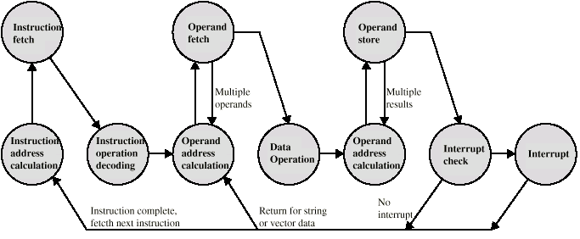
INSTRUCTION CYCLE (WITH INTERRUPTS) - STATE DIAGRAM

Slide 20

INSTRUCTION CYCLE WITH INTERRUPTS

Slide 21

TRANSFER OF CONTROL VIA INTERRUPTS

Slide 22
MULTIPLE INTERRUPTS
Disable interrupts
  Processor will ignore further interrupts whilst processing one interrupt
  Interrupts remain pending and are checked after first interrupt has been processed
  Interrupts handled in sequence as they occur
Define priorities
  Low priority interrupts can be interrupted by higher priority interrupts
  When higher priority interrupt has been processed, processor returns to previous interrupt

Slide 23

MULTIPLE INTERRUPTS - SEQUENTIAL

Slide 24
MULTIPLE INTERRUPTS – NESTED

Slide 25
REFERENCE
Computer Organization & Architecture By William Stallings (9th Edition)
Chapter # 2, 3 (Section 3.2)

